Slide 1
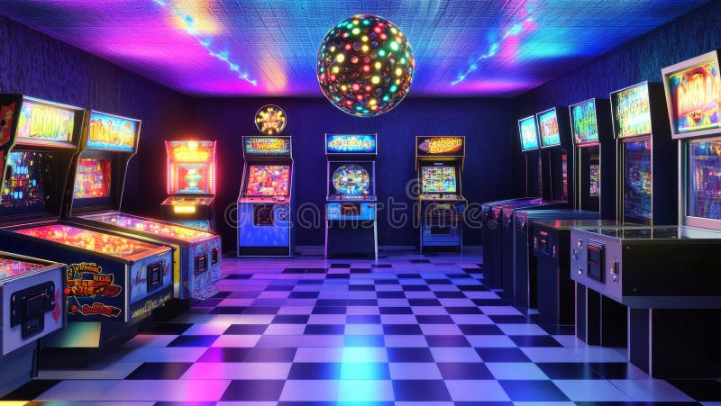
👾
THE GOLDEN AGE
OF ARCADE GAMES
1978-1983
When Quarters Ruled the World

Slide 2
CONTENTS
01
The Dawn of a New Era
02
Iconic Games
How Space Invaders sparked a revolution
Characters that became cultural phenomena
03
The Business of Fun
04
Cultural Impact
Billions of quarters, an economic force
From niche hobby to global phenomenon
05
The Decline and Beyond
The crash that changed everything and the phoenix that rose

Slide 3
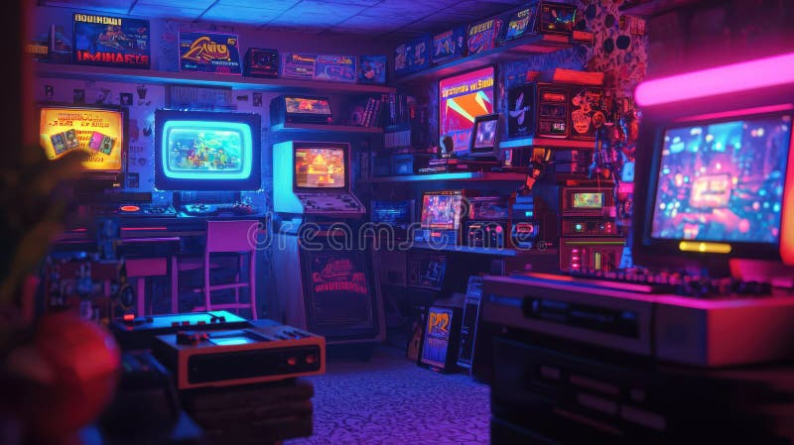
CHAPTER 01
THE DAWN OF
A NEW ERA
How a Japanese Space Shooter
Changed Everything

Slide 4
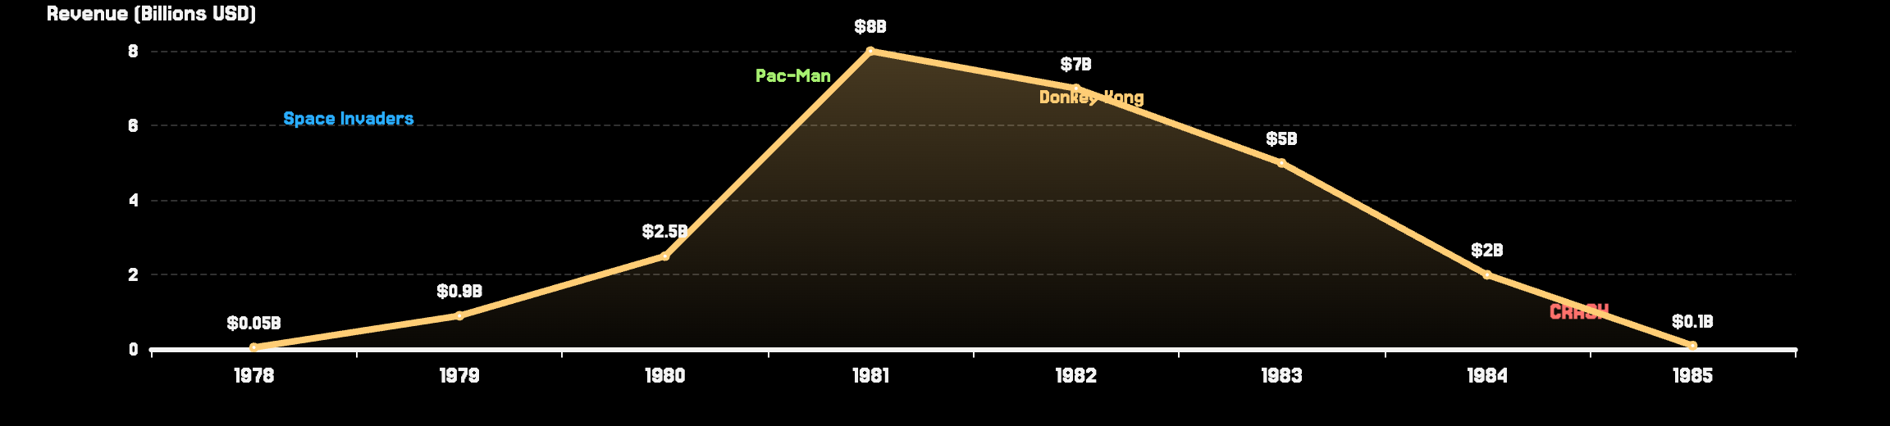
THE TIMELINE
When Was the Golden Age?
DEBATED TIMEFRAME
KEY MILESTONE
While experts disagree on exact dates, most place the golden age between 1978-1983. Some extend it to 1971 (first arcade game) or end at 1985 (industry recovery).
Space Invaders (1978) is universally recognized as the catalyst that transformed arcades from novelty to cultural phenomenon.
THE GOLDEN AGE TIMELINE

Slide 5
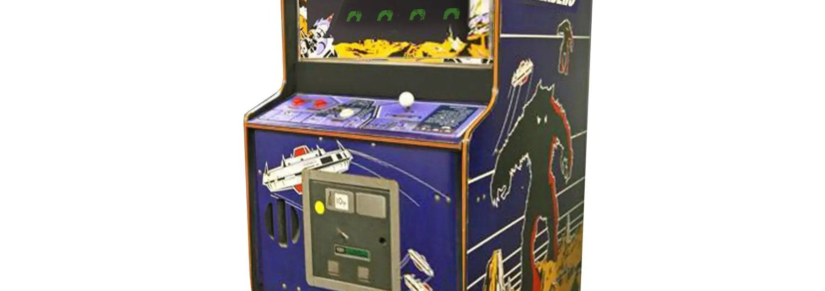
SPACE INVADERS
The Spark That Ignited the Revolution
THE CREATOR
Tomohiro Nishikado at Taito spent one year designing custom hardware using an Intel 8080 CPU—pushing technological limits of the time.
Inspired by Star Wars and H.G. Wells' War of the Worlds, he created alien designs based on octopus, squid, and crabs.
750,000
THE HAPPY ACCIDENT
Machines Worldwide by 1979
The game's signature increasing speed was originally a hardware limitation! As Nishikado destroyed more aliens, the processor rendered frames faster. Instead of fixing it, he made it a feature—creating tension that defined the game.
First High Score
Multiple Lives
$670M
Revenue in Japan Alone (1978)
Destructible Barriers
Continuous Soundtrack

Slide 6
TECHNOLOGY EVOLUTION
From Paddles to Microprocessors
PRE-GOLDEN AGE
GOLDEN AGE
Simple discrete logic circuits
Microprocessors (Intel 8080)
Black & white displays
Color displays & overlays
Basic beep sounds
Custom sound chips
Simple ball-and-paddle games
Complex gameplay & AI
Pong Era (1972)
Space Invaders Era (1978+)
MICROPROCESSORS
VECTOR GRAPHICS
SOUND INNOVATION
Enabled complex game logic, AI enemy behavior, and dynamic gameplay
Asteroids (1979) used crisp line graphics instead of pixels
Dedicated sound chips created immersive audio experiences
The Result: Games evolved from simple distractions to immersive experiences that captivated millions

Slide 7
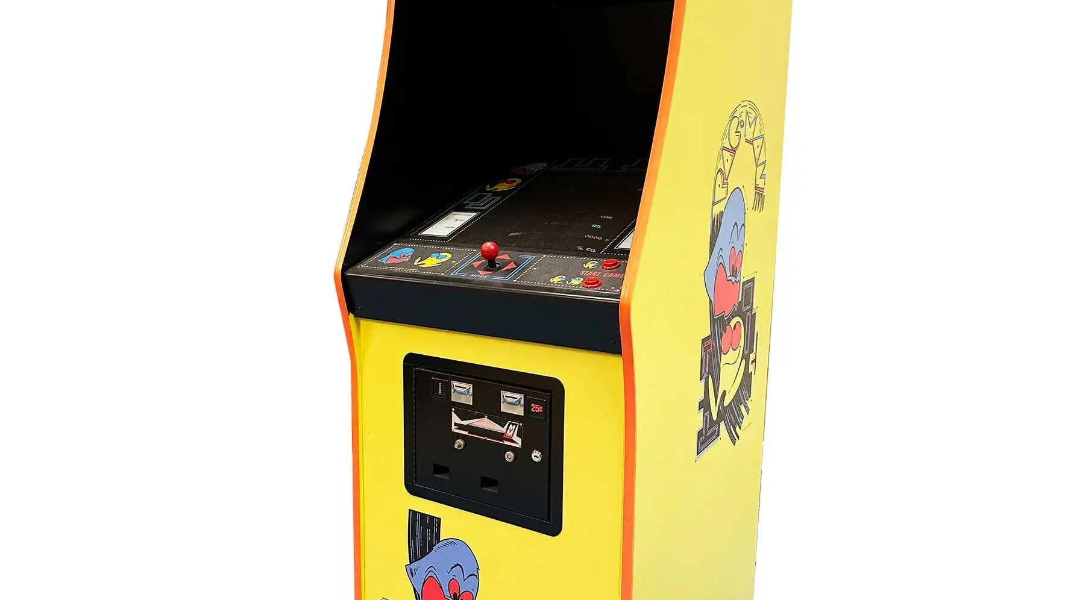
CHAPTER 02
ICONIC GAMES
THAT DEFINED
A GENERATION
The Characters and Experiences
That Became Cultural Phenomena

Slide 8
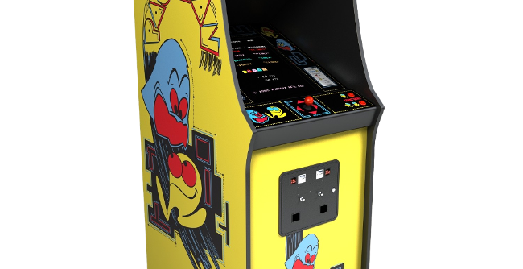
PAC-MAN
Eating the Competition
THE VISIONARY
Toru Iwatani wanted to create something completely different from the violent shooters dominating arcades. His goal: "A game that anyone can enjoy."
He noticed arcades were seen as "hangouts for delinquents" and set out to change that perception with non-violent, universally appealing gameplay.
$14B+
THE LEGENDARY DESIGN
The iconic character was born when Iwatani saw a pizza with a slice missing—the shape reminded him of a mouth. Combined with the Japanese "mouth" (kuchi) character, Pac-Man was born.
Total Global Revenue
Highest-grossing arcade game ever
Each ghost has distinct AI personality: Blinky (chase), Pinky (ambush), Inky (unpredictable), Clyde (random).
Released: May 1980
Developer: Namco
Appealed to Women
Family-Friendly
Global Icon

Slide 9
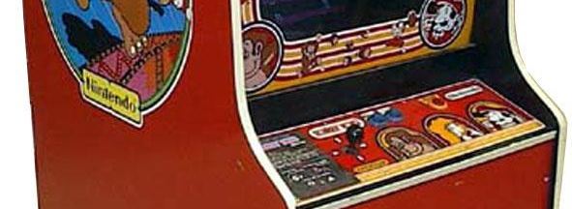
DONKEY KONG
The Birth of a Plumber
THE RESCUE MISSION
Nintendo of America was drowning in unsold Radar Scope machines. President Hiroshi Yamauchi tasked Shigeru Miyamoto with creating a game to convert them.
Miyamoto had never designed a game before. His advantage? He wasn't a programmer—he focused on story first, technology second.
$280M
FROM POPEYE TO PLUMBER
Revenue by End of 1982
Miyamoto wanted to use Popeye characters but couldn't secure the license. So he created original characters: a gorilla (Bluto became Donkey Kong), a hero (Popeye became Jumpman), and a damsel (Olive Oyl became Pauline).
Saved Nintendo of America
Jumpman was renamed "Mario" after Nintendo's Seattle landlord, Mario Segale, who demanded overdue rent.
LEGAL VICTORY
Released: July 1981
Universal Studios sued Nintendo claiming Donkey Kong infringed on King Kong. Nintendo won, with Universal ordered to pay $1.8 million in legal fees. The attorney, John Kirby, received a sailboat named "Donkey Kong."
Developer: Nintendo

Slide 10
THE HALL OF FAME
Top 10 Arcade Legends
01
Pac-Man
06
Galaga
1980 • Maze-chase perfection
1981 • Space shooter perfection
02
Space Invaders
07
Defender
1978 • Shooting genre pioneer
1981 • Complex controls
03
Donkey Kong
08
Asteroids
1981 • Platform gaming pioneer
1979 • Vector graphics
04
Street Fighter II
09
Centipede
1991 • Fighting game standard
1981 • Trackball innovation
05
Ms. Pac-Man
10
Mortal Kombat
1982 • Refined gameplay
1992 • Digitized graphics
These games generated billions in revenue and established gaming archetypes that persist today

Slide 11
CHAPTER 03
THE BUSINESS
OF FUN
Billions of Quarters:
An Economic Phenomenon

Slide 12
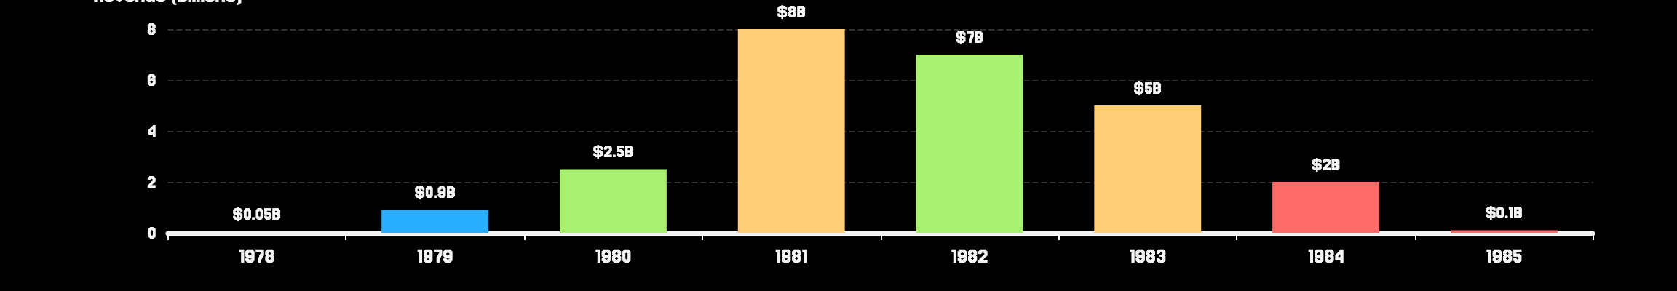
INDUSTRY REVENUE
Peak and Decline
THE PEAK
THE DECLINE
$8 Billion
$100M
1981 Revenue
1985 Revenue
Nearly 4x movie box office ($3.2B)
97% decline in just 4 years
24,000
1.5M
$7B
$5B
Full Arcades
Machines
1982
1983
REVENUE TRAJECTORY

Slide 13
THE POWER PLAYERS
Companies That Ruled the Arcades
ATARI
NAMCO
TAITO
Key Games:
Key Games:
Key Games:
• Asteroids (1979)
• Pac-Man (1980)
• Space Invaders (1978)
• Centipede (1981)
• Galaga (1981)
• Bubble Bobble (1986)
• Tempest (1981)
• Dig Dug (1982)
• Arkanoid (1986)
Pioneered vector graphics
Created gaming icons
Started the golden age
NINTENDO
MIDWAY
WILLIAMS
Key Games:
Key Games:
Key Games:
• Donkey Kong (1981)
• Pac-Man (US dist.)
• Defender (1981)
• Mario Bros. (1983)
• Ms. Pac-Man (1982)
• Joust (1982)
• Popeye (1982)
• Galaga (US dist.)
• Robotron 2084 (1982)
Created Mario universe
Major US distributor
Innovative gameplay

Slide 14

CHAPTER 04
CULTURAL IMPACT
& LEGACY
From Niche Hobby
to Global Phenomenon

Slide 15
ARCADES AS SOCIAL HUBS
Where Youth Culture Thrived
GATHERING PLACES
HIGH-SCORE WARS
A SAFE HAVEN
Arcades became the malls of the 80s—where teenagers hung out, made friends, and built communities around shared interests.
Competing for top scores created social currency. Being the best at Pac-Man or Donkey Kong brought status and respect.
For many teens, arcades offered a refuge—a place to escape, belong, and connect with like-minded peers.
ARCADE EXPLOSION
SOCIAL DYNAMICS
Video Game Arcades (1980)
4,000
Crowds gathered around skilled players
Video Game Arcades (1982)
10,000+
Strategies shared among players
Full Arcades (1982)
24,000
Friendships formed over shared passion
Active Machines (1982)
1.5 Million
Rivalries developed between regulars

Slide 16
POP CULTURE INVASION
When Games Became Icons
HOLLYWOOD
MUSIC & TV
Music videos featured arcade imagery. TV shows like "Starcade" (1982-84) made gaming a spectator sport. Pac-Man even got his own Saturday morning cartoon (1982-83).
TRON (1982)
First movie set inside a video game
The Last Starfighter (1984)
FASHION
Arcade game as gateway to space adventure
Bright, neon colors from game screens influenced 80s fashion. Arcade-inspired patterns appeared on clothing, creating a distinctive aesthetic of the era.
WarGames (1983)
Gaming culture meets Cold War tension
MERCHANDISE
COMICS
CEREAL
MEDIA
Lunch boxes, toys, bedsheets
Game-based comic books
Pac-Man breakfast cereal
Newspaper coverage, strategy guides
Games became cultural touchstones recognized worldwide—transcending entertainment to become symbols of a generation

Slide 17
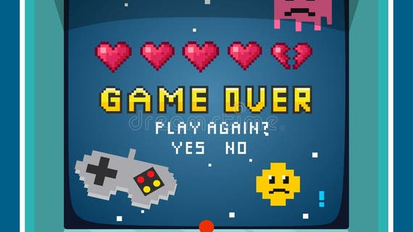
CHAPTER 05
THE DECLINE
AND BEYOND
The Crash That Changed Everything

Slide 18
THE VIDEO GAME CRASH OF 1983
When the Industry Collapsed
THE PERFECT STORM
THE DEVASTATION
Market Oversaturation
97%
Too many low-quality games flooded the market
Revenue Decline
Loss of Consumer Trust
$3.2B → $100M (1983-1985)
Poor games destroyed buyer confidence
Atari's Loss
Home Computer Rise
$350 million in 1983 alone
PCs offered better value than arcades
The Landfill
Unsold cartridges buried in New Mexico
COMPANIES FOLDED
LAYOFFS
ARCADES CLOSED
U.S. Games, Magnavox, and dozens more
Thousands lost jobs industry-wide
Many arcades shut down permanently
By 1985, the industry was on its knees. But from the ashes, a phoenix would rise...

Slide 19
THE PHOENIX RISES
Nintendo's Redemption
THE NEWCOMER ARRIVES
THE RESULT
In 1985, a Japanese company entered the US market with a revolutionary approach: the Nintendo Entertainment System (NES).
90%
Nintendo studied the crash's lessons and implemented strict quality control to prevent another market collapse.
US Console Market Share by 1987
Consumer Confidence Restored
THE NINTENDO STRATEGY
Nintendo's seal of quality reassured buyers
Third-party licensing: Controlled who could make games
Quality standards: Every game required approval
Industry Foundation Rebuilt
Marketing: Repositioned NES as "entertainment system"
Modern gaming business model established
Iconic games: Super Mario Bros., The Legend of Zelda
THE ARCADE LEGACY
NES games like Super Mario Bros. and Donkey Kong brought arcade-quality experiences into living rooms—preserving the golden age's innovations for future generations.

Slide 20
🕹️
THE LEGACY
LIVES ON
The golden age of arcade games established principles that still drive the industry today:
Competitive Gaming Culture
Social Experiences
Iconic Character Design
Games for Everyone
Every mobile game, esports tournament, and modern arcade traces its roots to those neon-lit rooms of the 1980s.
INSERT COIN TO CONTINUE
The game never really ended.

